Slide 1
STUDENT DBMS
MYSQL-PYTHON PROJECT
By
  Giridharan S (22ITR025)
  Ashoknirmal P S (22ITR009)
  Bharath M (22ITR012)

Slide 2
ABSTRACT
The Student DBMS Python Project is a holistic solution designed to manage student information using an intuitive Python interface. This report delineates the project's origins, goals, and essential features.
With its user-friendly design and robust functionality, the project efficiently manages student databases, simplifying complexities and meeting the demand for streamlined organization in diverse educational domains.

Slide 3
INTRODUCTION
Efficiency
Automation
User-Friendly
Simplify data entry and modification, enhancing overall system efficiency for streamlined student details and information management.
Automate GPA and CGPA calculations, ensuring accurate and hassle-free academic assessments for precise performance evaluation.
Navigate through intuitive CRUD operations, promoting user-friendly interactions for effective and organized data management.

Slide 4
Student DBMS
Database Structure
Efficient MySQL-Python collaboration for clear data manipulation.
System Architecture
Code Overview
The project uses a MySQL database with 'details' and 'marks' tables linked via foreign keys.

Slide 5
Features and Functionalities
Add New Records
Academic Records
Streamlined process for adding new student information with precision.
Input subject-wise credits and grades for comprehensive academic records.
Modify & Purge
CRUD Operations
Effortlessly update and ensure data hygiene with precision.
Efficiently perform CRUD operations for data management.
Calculate Marks
View Specific
Automated GPA and CGPA calculation for academic details.
Display details for a particular record with precision.

Slide 6
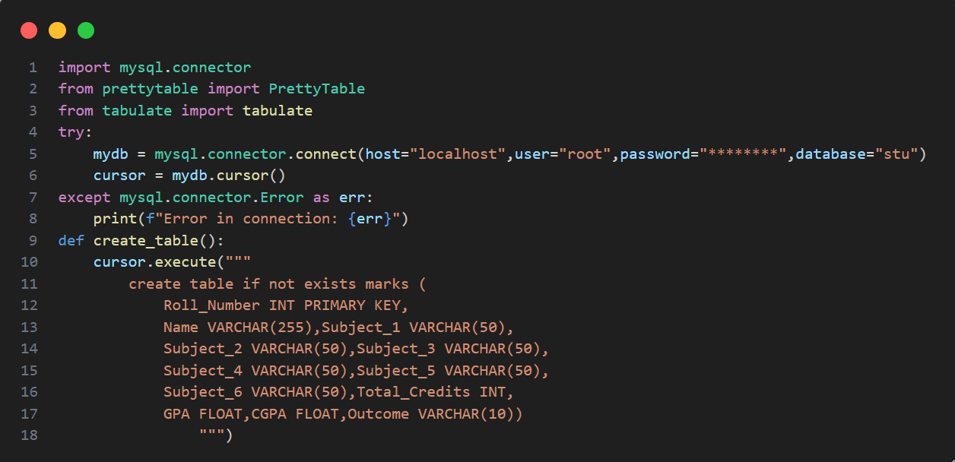
PYTHON – MYSQL CODE :
ACADEMIC.py

Slide 7
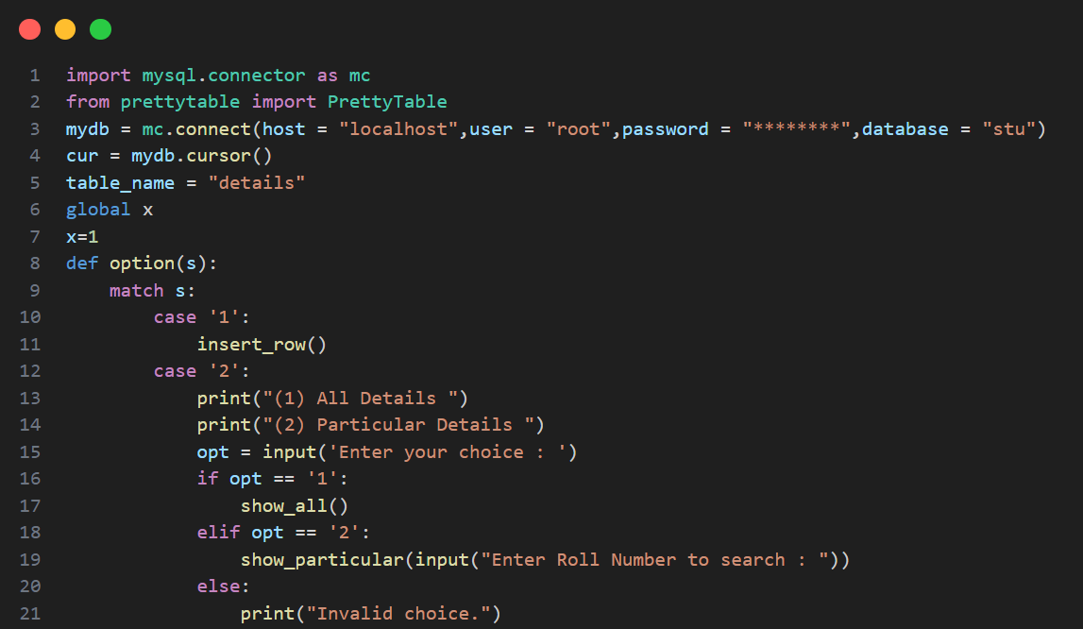
PERSONAL.py

Slide 8
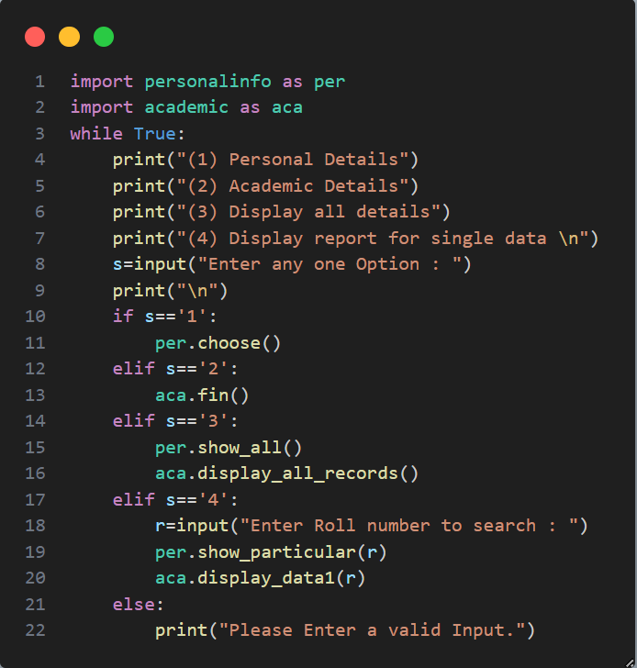
MAIN.py

Slide 9
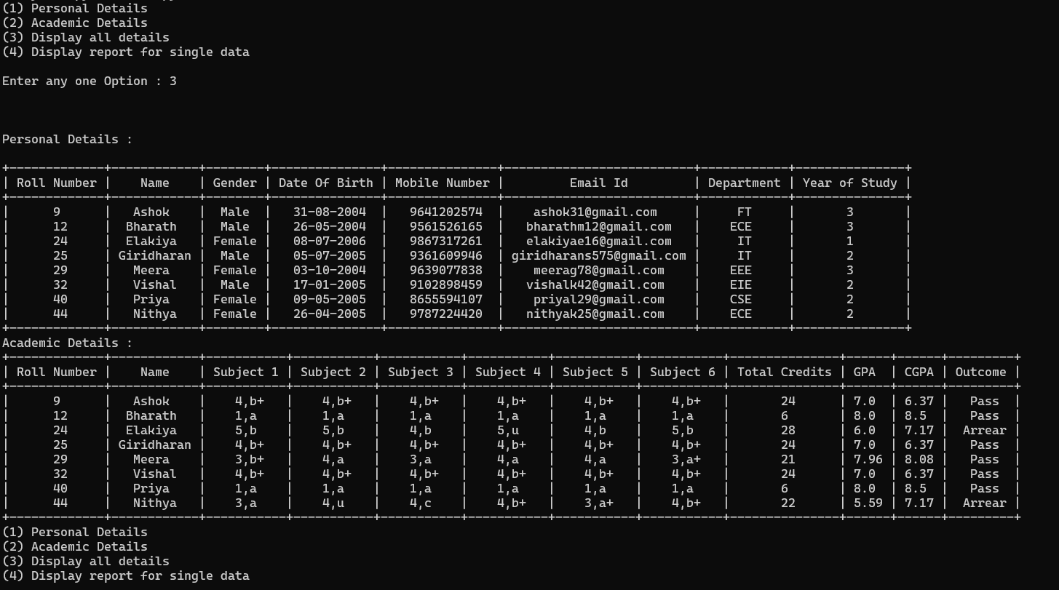
OUTPUT OF THE PROJECT
RECORD FOR ALL STUDENTS

Slide 10
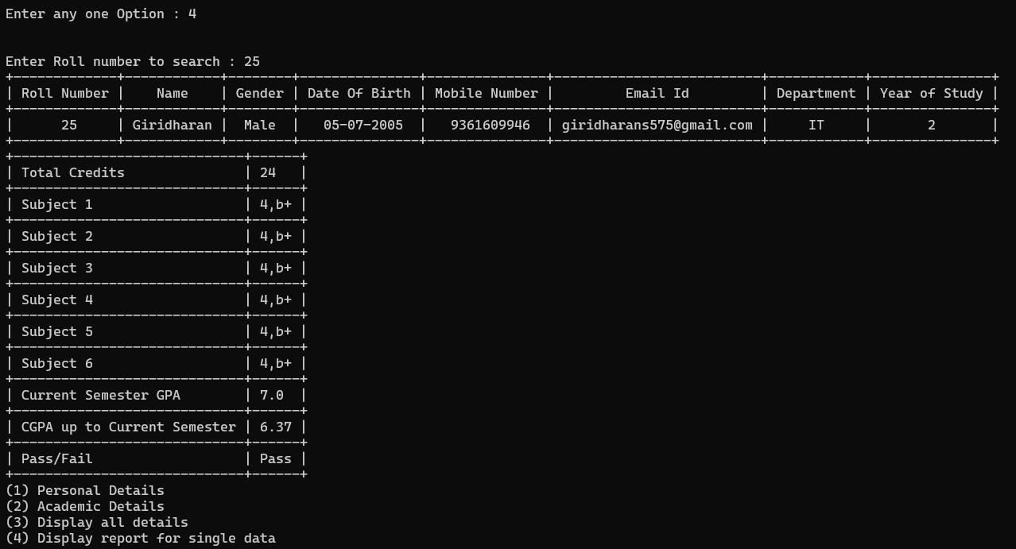
RECORD FOR ONE STUDENT

Slide 11
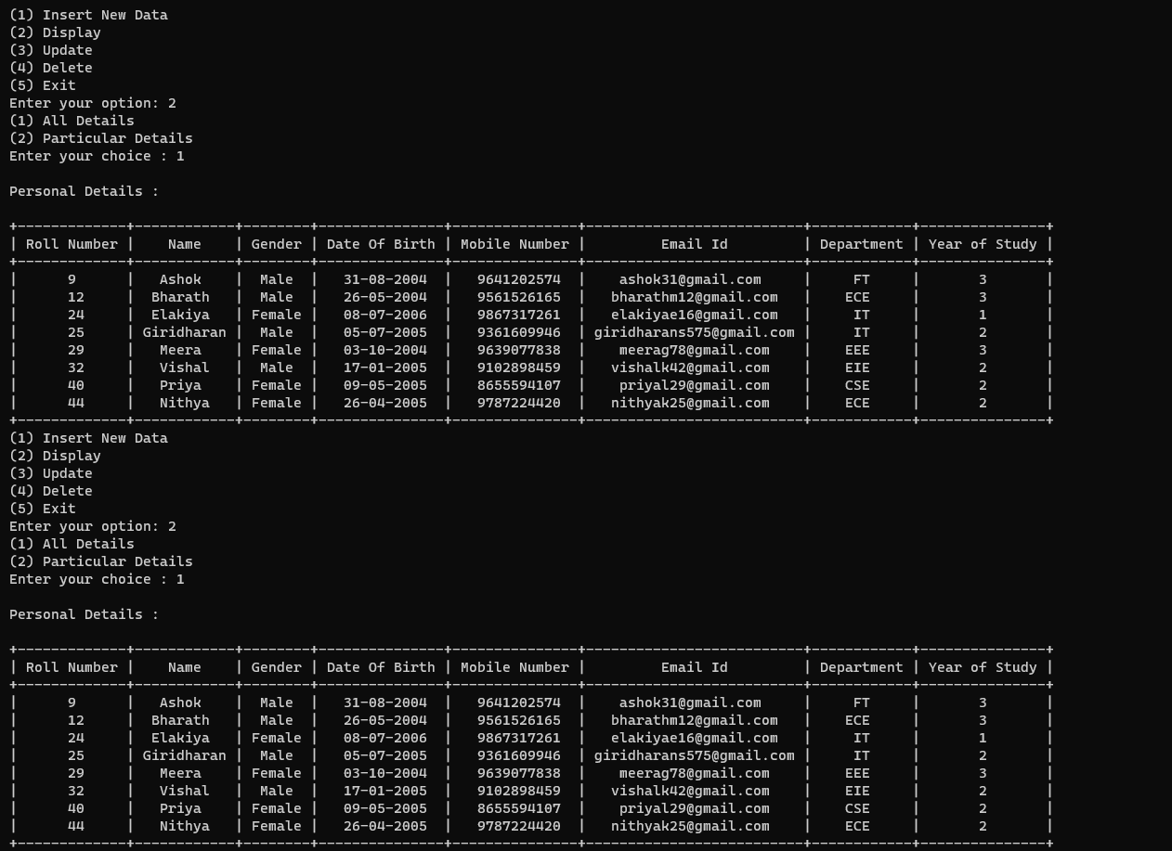
RECORD FOR PERSONAL DETAILS

Slide 12
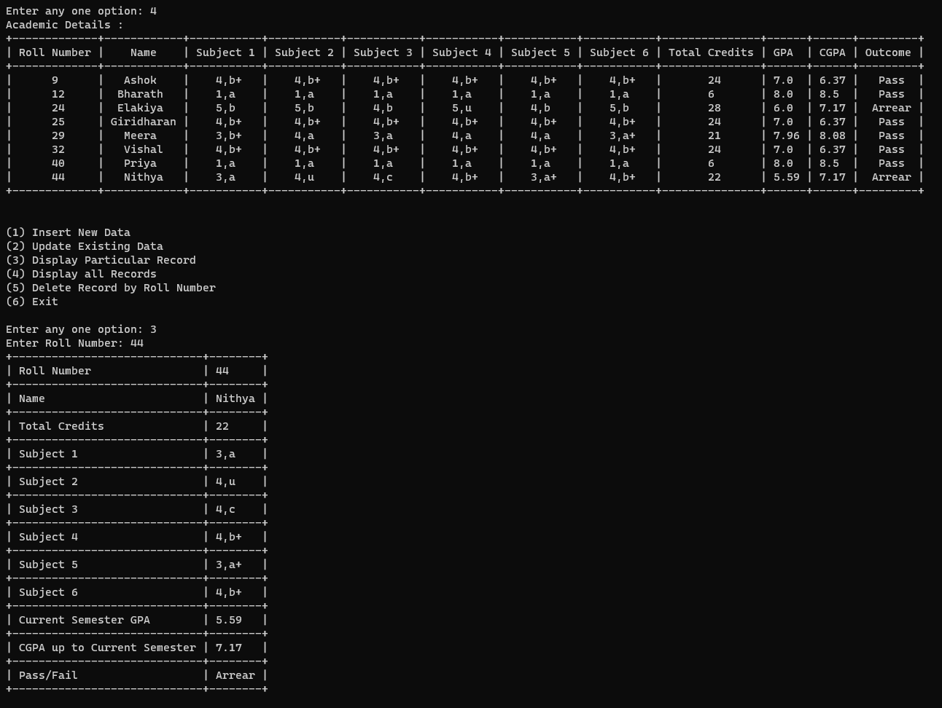
RECORD FOR ACADEMIC DETAILS

Slide 13
CONCLUSION
The "Student Database Management System" enhances record management efficiency. It automates academic assessments, ensuring accurate GPA and CGPA calculations.
With user-friendly CRUD operations, it simplifies data interactions and organized information management for both personal and academic records.

Slide 14





